Slide 1
Communicating over the Network
Network Fundamentals – Chapter 2

Slide 2
Objectives
Describe the structure of a network, including the devices and media that are necessary for successful communications.
Explain the function of protocols in network communications.
Explain the advantages of using a layered model to describe network functionality.
Describe the role of each layer in two recognized network models: The TCP/IP model and the OSI model.
Describe the importance of addressing and naming schemes in network communications.

Slide 3
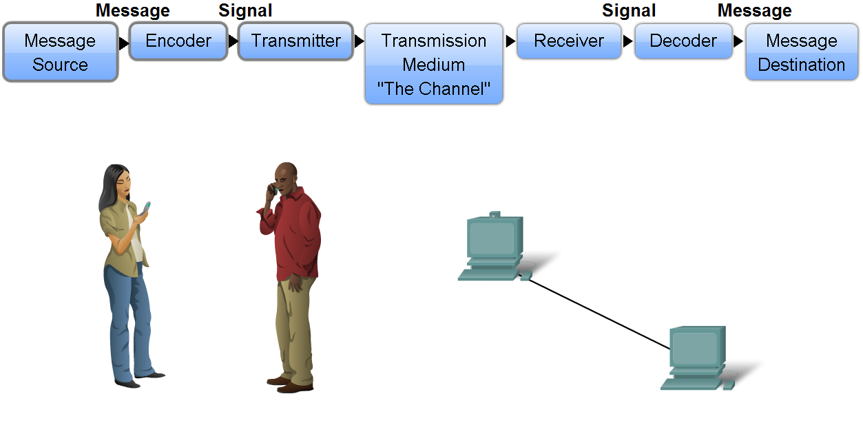
Network Structure
Define the elements of communication
  3 common elements of communication
    message source
    the channel
    message destination
Define a network
  data or information networks capable of carrying many different types of communications

Slide 4
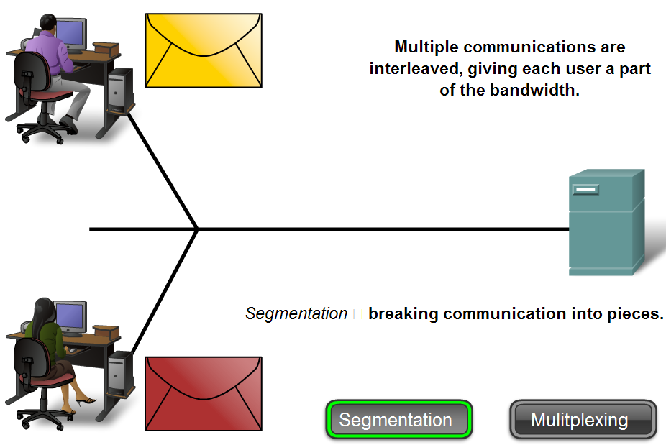
Network Structure
Describe how messages are communicated
  Data is sent across a network in small “chunks” called segments

Slide 5
Segmentation
Segmenting messages has two primary benefits.
First, by sending smaller individual pieces from source to destination, many different conversations can be interleaved on the network. The process used to interleave the pieces of separate conversations together on the network is called multiplexing.
Second, segmentation can increase the reliability of network communications. The separate pieces of each message need not travel the same pathway across the network from source to destination. If a particular path becomes congested with data traffic or fails, individual pieces of the message can still be directed to the destination using alternate pathways. If part of the message fails to make it to the destination, only the missing parts need to be retransmitted.

Slide 6
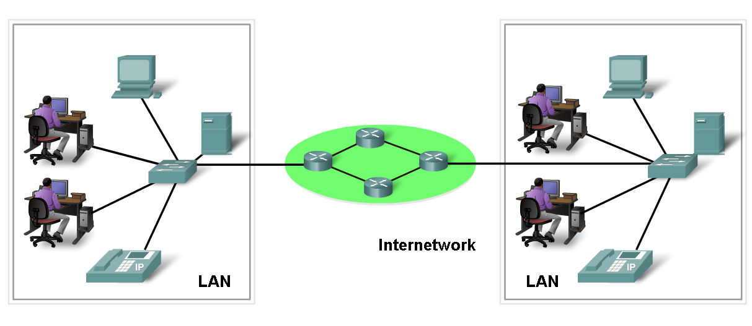
Network Structure
Define the components of a network
  Network components
    hardware
    software

Slide 7
Hardware and Software
Devices and media are the physical elements or hardware of the network. Hardware is often the visible components of the network platform such as a laptop, a PC, a switch, or the cabling used to connect the devices. Occasionally, some components may not be so visible. In the case of wireless media, messages are transmitted through the air using invisible radio frequency or infrared waves.
Services and processes are the communication programs, called software, that run on the networked devices. A network service provides information in response to a request. Services include many of the common network applications people use every day, like e-mail hosting services and web hosting services. Processes provide the functionality that directs and moves the messages through the network. Processes are less obvious to us but are critical to the operation of networks.

Slide 8
End Devices
The network devices that people are most familiar with are called end devices. These devices form the interface between the human network and the underlying communication network. Some examples of end devices are:
Computers (work stations, laptops, file servers, web servers)
Network printers
VoIP phones
Security cameras
Mobile handheld devices (such as wireless barcode scanners, PDAs)

Slide 9
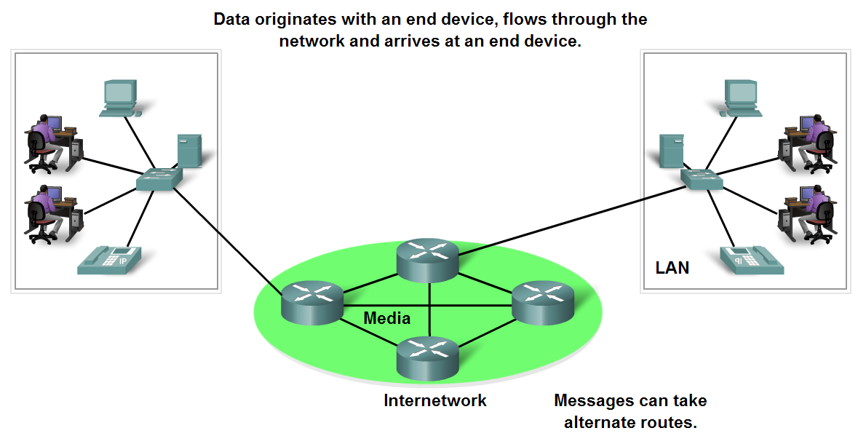
Network Structure
End Devices and their Role in the Network
  End devices form interface with human network & communications network
  Role of end devices:
    client
    server
    both client and server

Slide 10
Intermediary Devices
In addition to the end devices that people are familiar with, networks rely on intermediary devices to provide connectivity and to work behind the scenes to ensure that data flows across the network.
These devices connect the individual hosts to the network and can connect multiple individual networks to form an internetwork. Examples of intermediary network devices are:
Network Access Devices (Hubs, switches, and wireless access points)
Internetworking Devices (routers)
Communication Servers and Modems
Security Devices (firewalls)

Slide 11
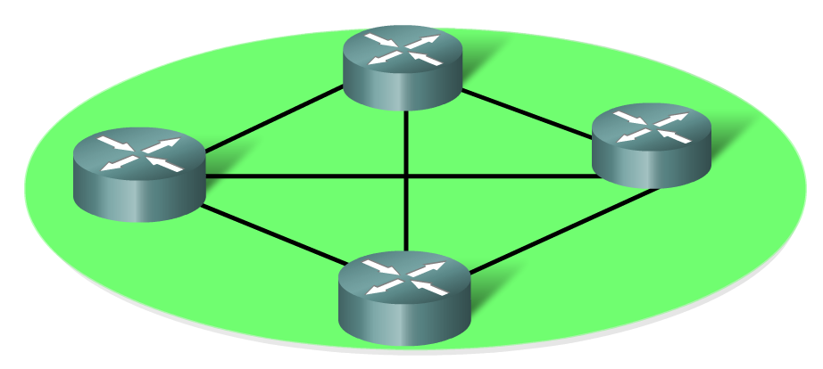
Network Structure
Identify the role of an intermediary device in a data network and be able to contrast that role with the role of an end device
  Role of an intermediary device
    provides connectivity and ensures data flows across network

Slide 12
Intermediary Device Functions
Regenerate and retransmit data signals
Maintain information about what pathways exist through the network and internetwork
Notify other devices of errors and communication failures
Direct data along alternate pathways when there is a link failure
Classify and direct messages according to QoS priorities
Permit or deny the flow of data, based on security settings

Slide 13
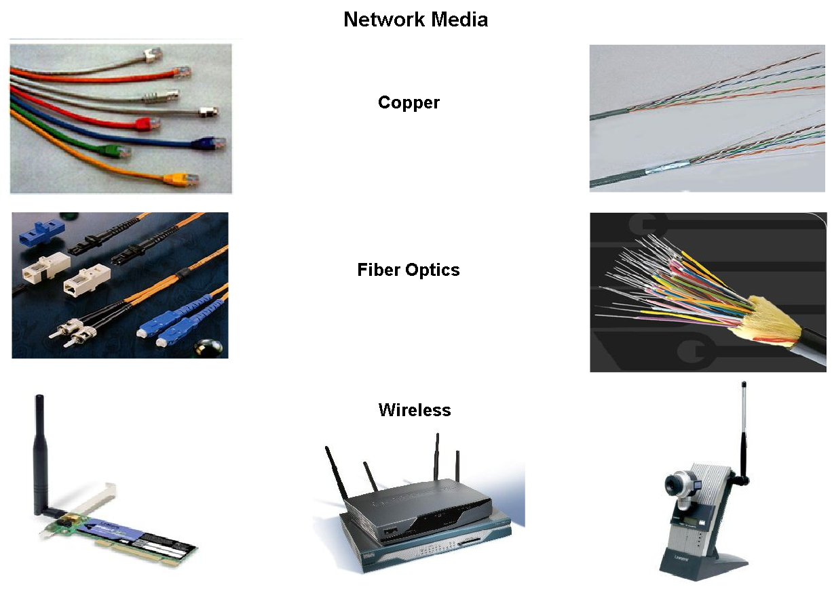
Network Structure
Define network media and criteria for making a network media choice
  Network media
  this is the channel over which a message travels

Slide 14
Networking Media
Modern networks primarily use three types of media to interconnect devices and to provide the pathway over which data can be transmitted. These media are:
Metallic wires within cables
Glass or plastic fibers (fiber optic cable)
Wireless transmission
The signal encoding that must occur for the message to be transmitted is different for each media type. On metallic wires, the data is encoded into electrical impulses that match specific patterns.
Fiber optic transmissions rely on pulses of light, within either infrared or visible light ranges. In wireless transmission, patterns of electromagnetic waves depict the various bit values.

Slide 15
Media Benefits
Different types of network media have different features and benefits. Not all network media has the same characteristics and is appropriate for the same purpose. Criteria for choosing a network media are:
The distance the media can successfully carry a signal.
The environment in which the media is to be installed.
The amount of data and the speed at which it must be transmitted.
The cost of the media and installation

Slide 16
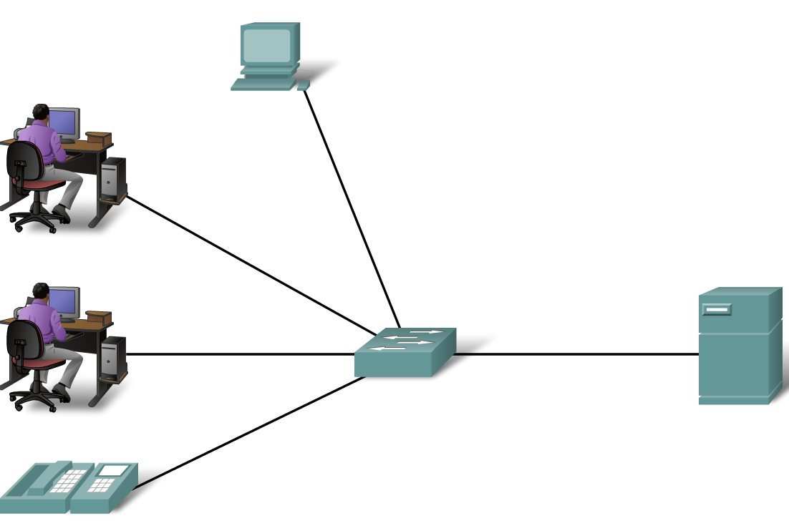
Network Types
Define Local Area Networks (LANs)
  - A network serving a home, building or campus is considered a Local Area Network (LAN)

Slide 17
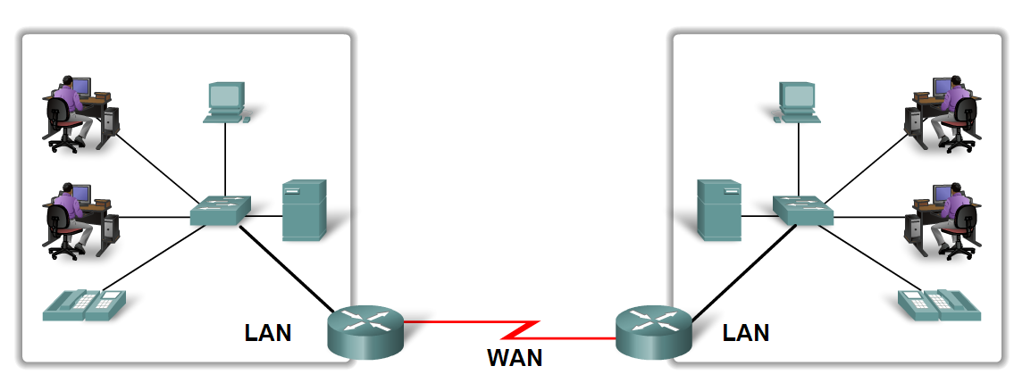
Network Types
Define Wide Area Networks (WANs)
  - LANs separated by geographic distance are connected by a network known as a Wide Area Network (WAN)

Slide 18
WANs
Requires a telecommunications service provider (TSP) to interconnect the LANs at the different locations.
Telecommunications service providers operate large regional networks that can span long distances.
These providers are offering converged information network services to their subscribers.
Organization maintains all of the policies and administration of the LANs at both ends of the connection, the policies within the communications service provider network are controlled by the TSP.
WANs incorporate high end devices to provide such services

Slide 19
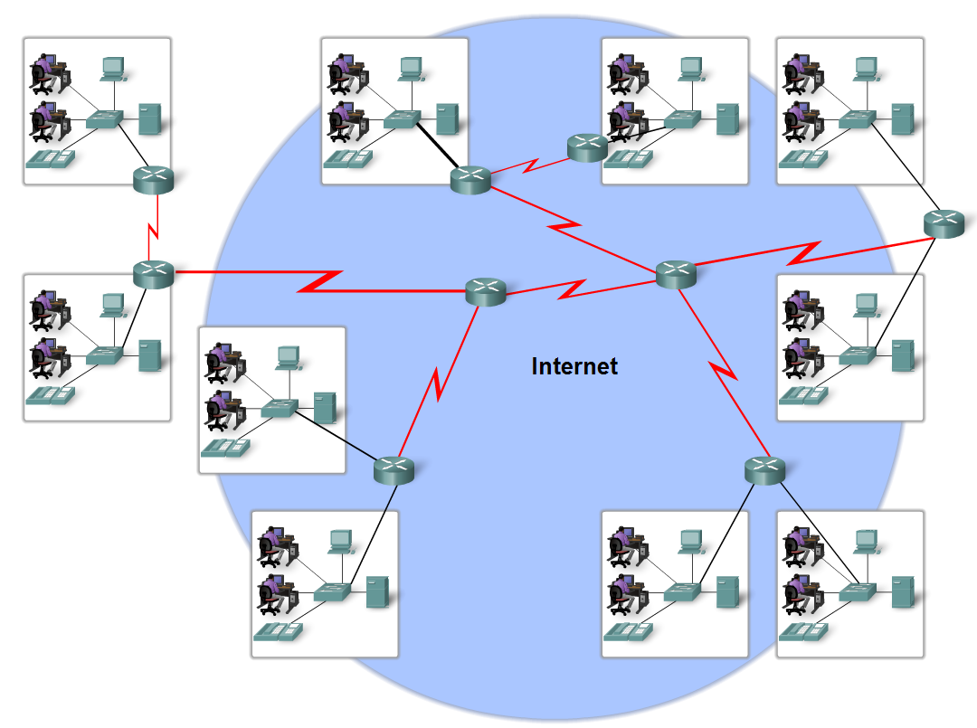
Network Types
Define the Internet
  The internet is defined as a
  global mesh of interconnected networks

Slide 20
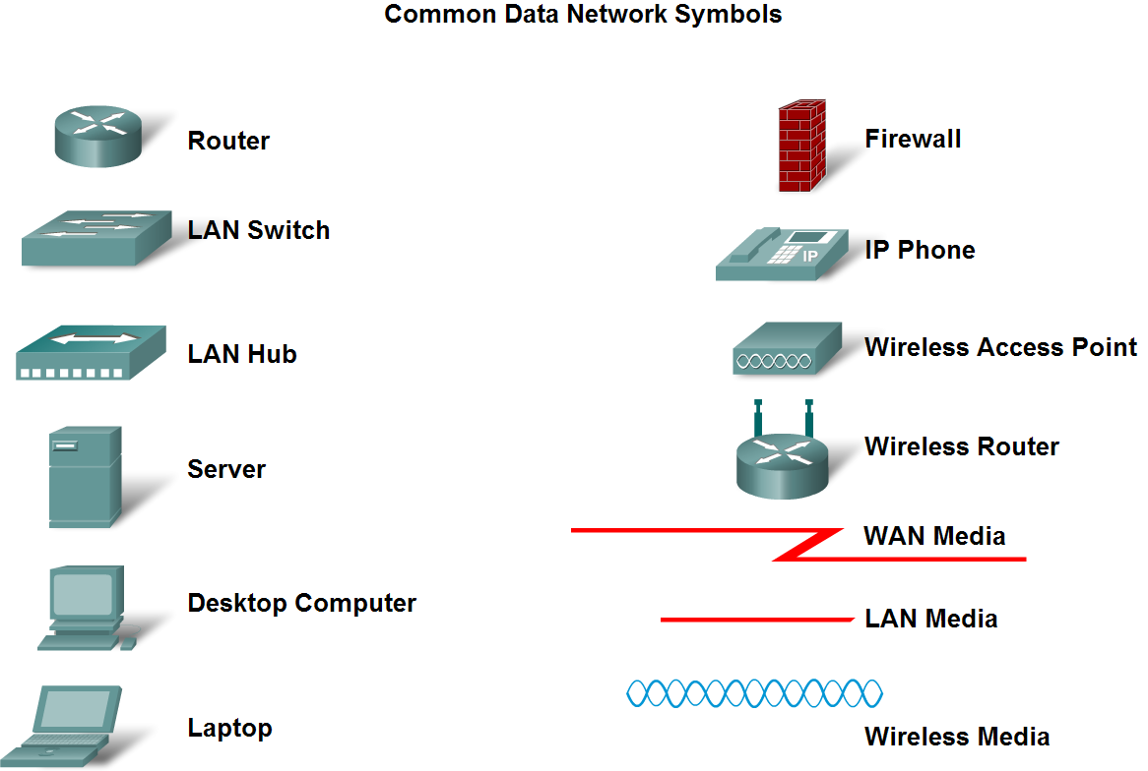
Network Types
Describe network representations

Slide 21
Terminology
Network Interface Card - A NIC, or LAN adapter, provides the physical connection to the network at the PC or other host device. The media connecting the PC to the networking device plugs directly into the NIC.
Physical Port - A connector or outlet on a networking device where the media is connected to a host or other networking device.
Interface - Specialized ports on an internetworking device that connect to individual networks. Because routers are used to interconnect networks, the ports on a router are referred to network interfaces.

Slide 22
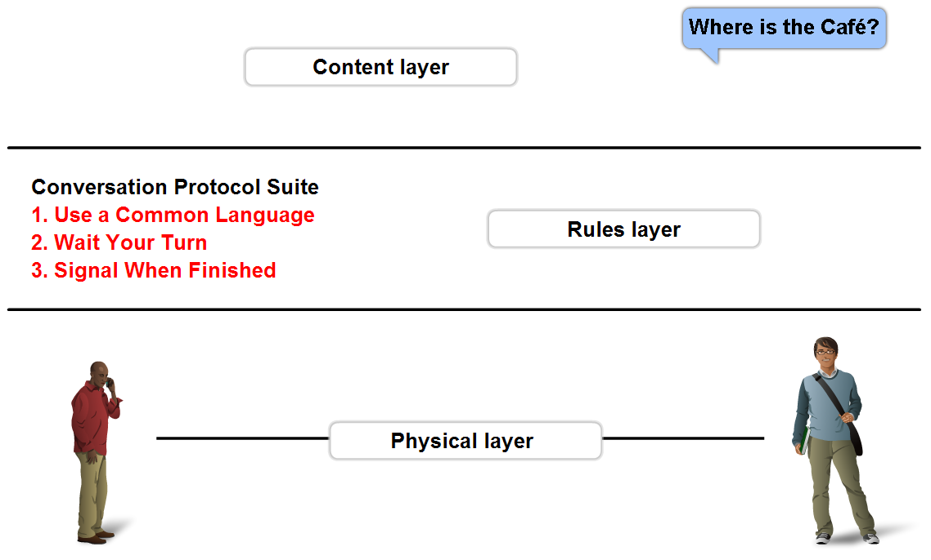
Function of Protocol in Network Communication
The importance of protocols and how they are used to facilitate communication over data networks
  A protocol is a set of predetermined rules

Slide 23
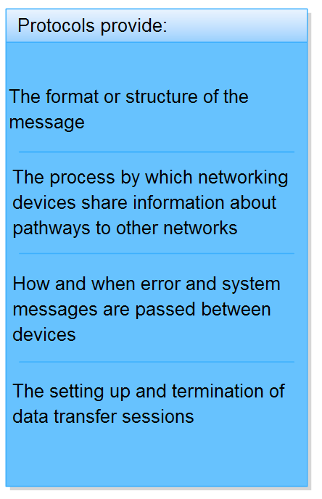
Function of Protocol in Network Communication
Explain network protocols
  Network protocols are used
  to allow devices to
  communicate
  successfully

Slide 24
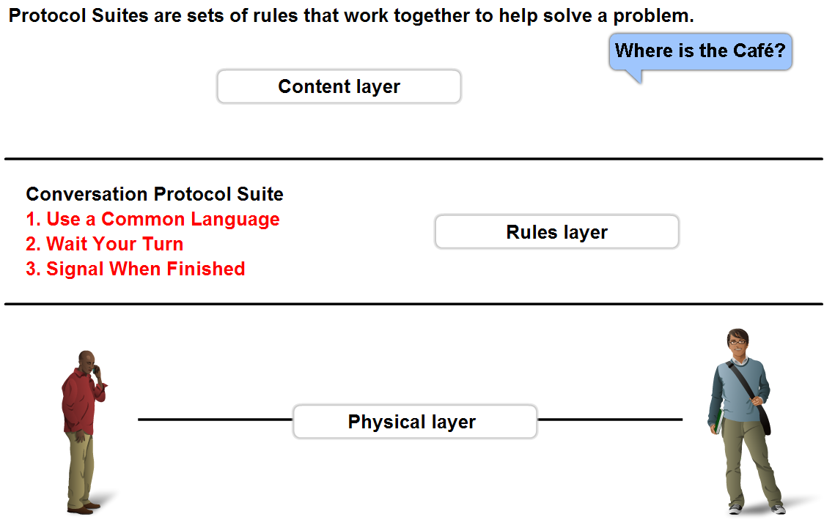
Function of Protocol in Network Communication
Describe Protocol suites and industry standards
  A standard is
  a process or protocol that has been endorsed by the networking industry and ratified by a standards organization

Slide 25
Protocol Stack
One of the best ways to visualize how all of the protocols interact on a particular host is to view it as a stack.
A protocol stack shows how the individual protocols within the suite are implemented on the host. The protocols are viewed as a layered hierarchy, with each higher level service depending on the functionality defined by the protocols shown in the lower levels.
The lower layers of the stack are concerned with moving data over the network and providing services to the upper layers, which are focused on the content of the message being sent and the user interface.

Slide 26
Protocol Suite
Networking protocol suites describe processes such as:
The format or structure of the message
The method by which networking devices share information about pathways with other networks
How and when error and system messages are passed between devices
The setup and termination of data transfer sessions
Individual protocols in a protocol suite may be vendor-specific and proprietary. Proprietary, in this context, means that one company or vendor controls the definition of the protocol and how it functions.
Some proprietary protocols can be used by different organizations with permission from the owner. Others can only be implemented on equipment manufactured by the proprietary vendor.

Slide 27
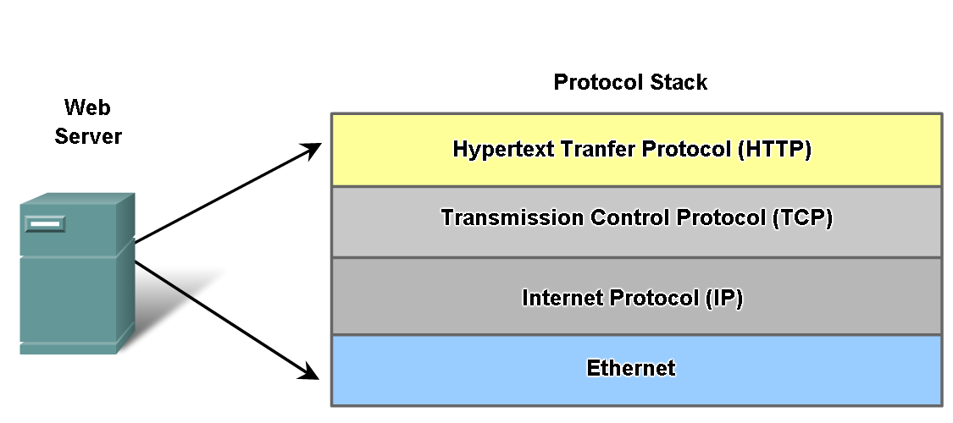
Function of Protocol in Network Communication
Define different protocols and how they interact

Slide 28
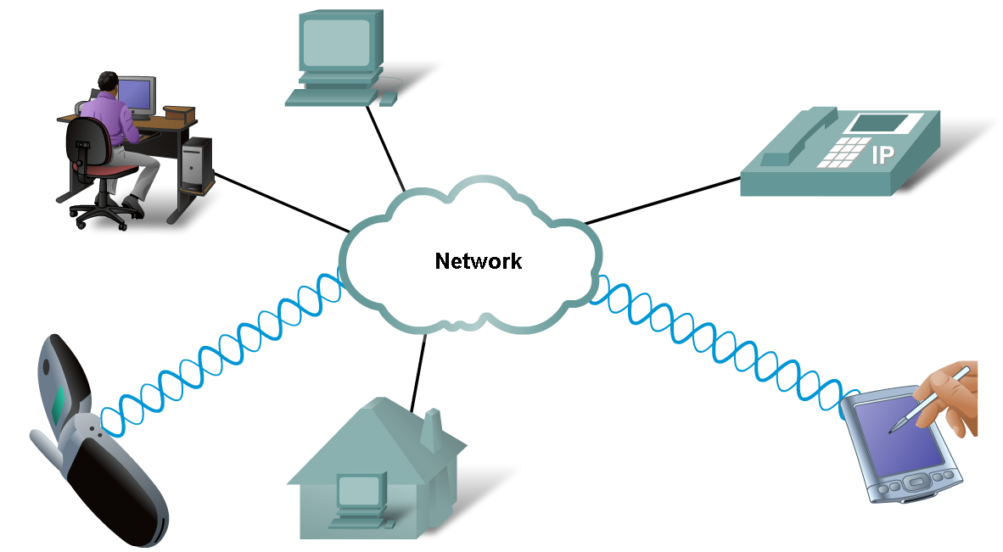
Function of Protocol in Network Communication
Technology independent Protocols
  -Many diverse types of devices can communicate using the same sets of protocols. This is because protocols specify network functionality, not the underlying technology to support this functionality.

Slide 29
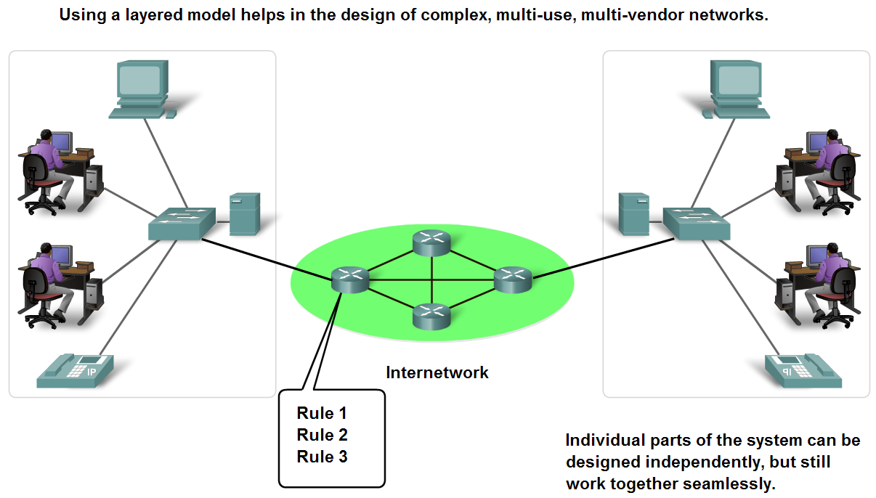
Layers with TCP/IP and OSI Model
Explain the benefits of using a layered model
  Benefits include
    assists in protocol design
    fosters competition
    changes in one layer do not affect other layers
    provides a common language

Slide 30
Reference Model
A protocol model provides a model that closely matches the structure of a particular protocol suite.
The hierarchical set of related protocols in a suite typically represents all the functionality required to interface the human network with the data network.
The TCP/IP model is a protocol model because it describes the functions that occur at each layer of protocols within the TCP/IP suite.
A reference model provides a common reference for maintaining consistency within all types of network protocols and services.
A reference model is not intended to be an implementation specification or to provide a sufficient level of detail to define precisely the services of the network architecture.
The primary purpose of a reference model is to aid in clearer understanding of the functions and process involved.

Slide 31
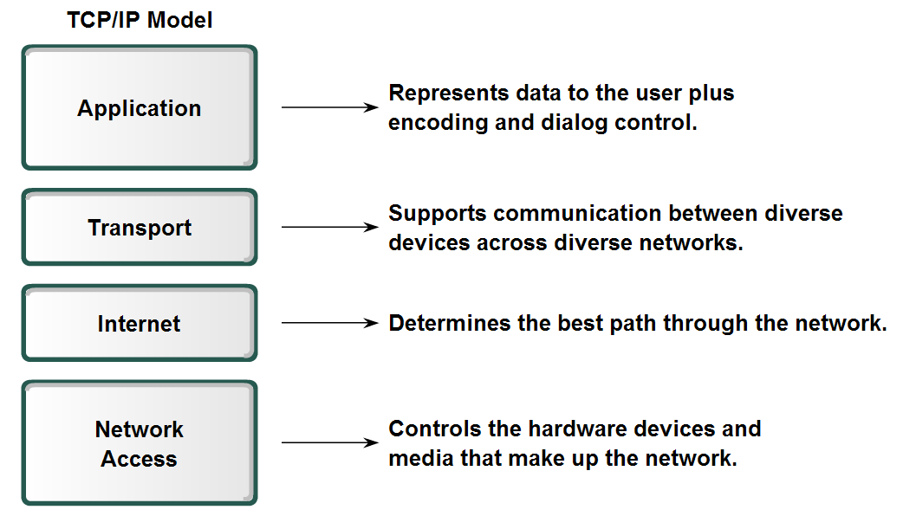
Layers with TCP/IP and OSI Model
Describe TCP/IP Model (RFC 1180)

Slide 32
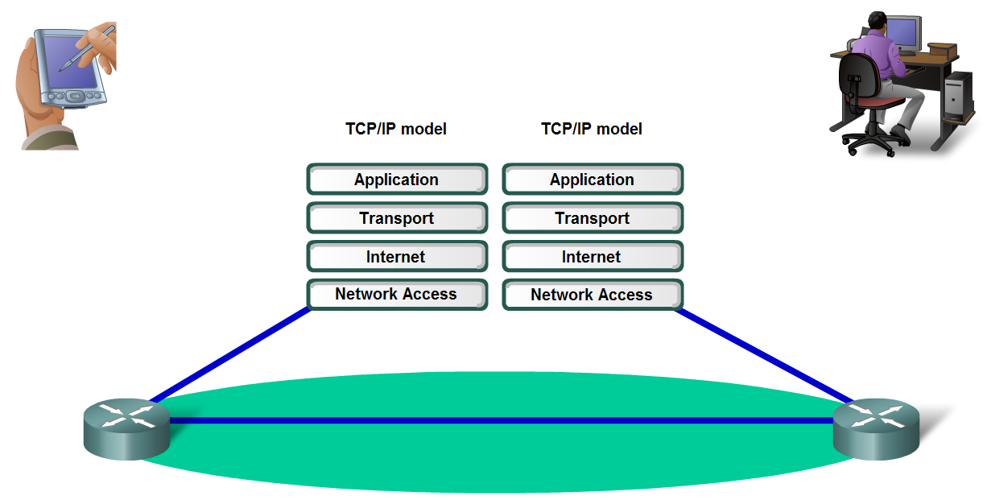
Layers with TCP/IP and OSI Model
Describe the Communication Process

Slide 33
Communication Steps
Creation of data at the Application layer of the originating source end device
Segmentation and encapsulation of data as it passes down the protocol stack in the source end device
Generation of the data onto the media at the Network Access layer of the stack
Transportation of the data through the internetwork, which consists of media and any intermediary devices
Reception of the data at the Network Access layer of the destination end device
Decapsulation and reassembly of the data as it passes up the stack in the destination device
Passing this data to the destination application at the Application layer of the destination end device

Slide 34
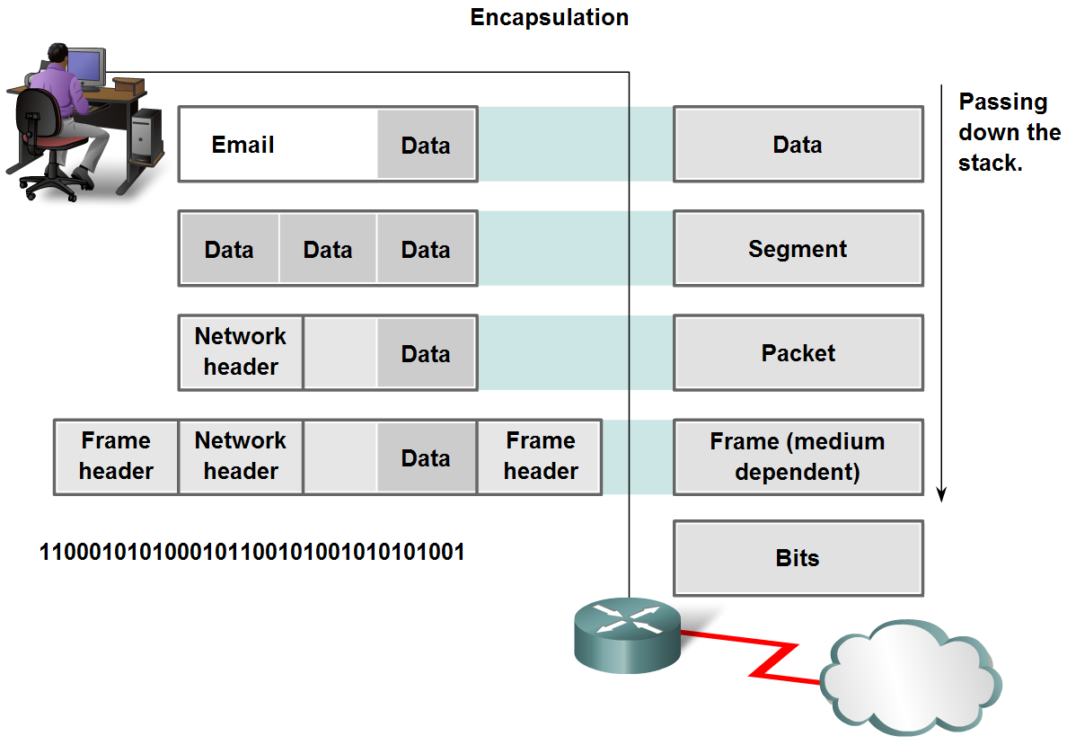
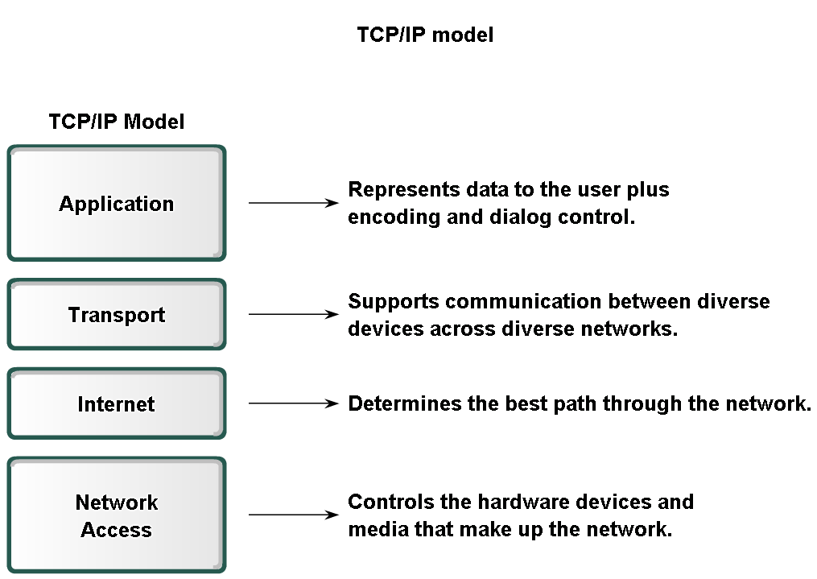
Layers with TCP/IP and OSI Model
Explain protocol data units (PDU) and encapsulation

Slide 35
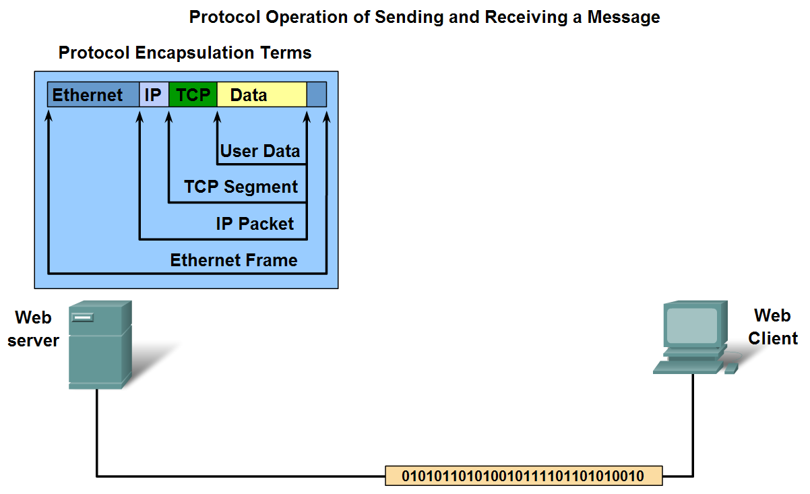
Layers with TCP/IP and OSI Model
Describe the process of sending and receiving messages

Slide 36
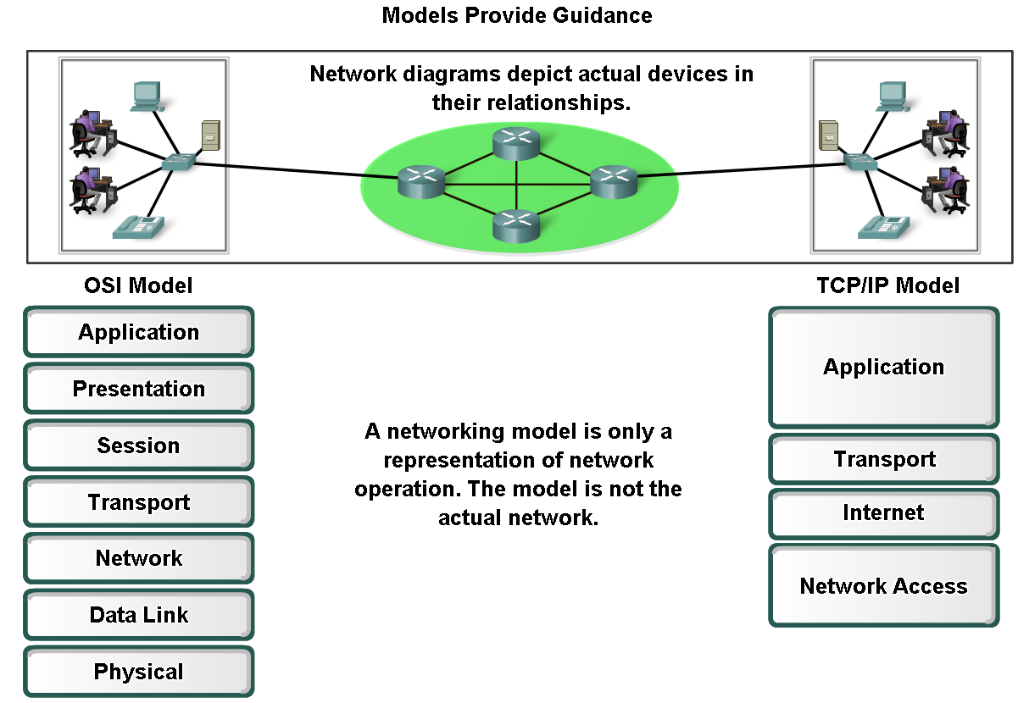
Layers with TCP/IP and OSI Model
Explain protocol and reference models
  A protocol model
  provides a model that closely matches the structure of a particular protocol suite.
  A reference model
  provides a common reference for maintaining consistency within all types of network protocols and services.

Slide 37
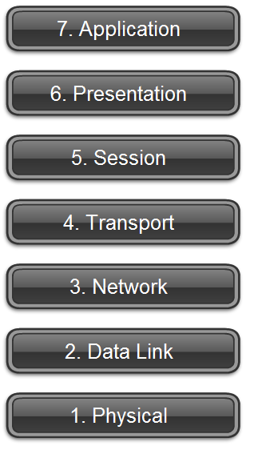
Layers with TCP/IP and OSI Model
Define OSI

Slide 38
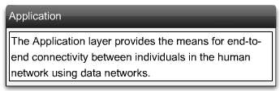
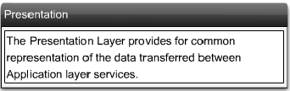
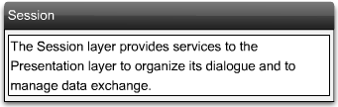
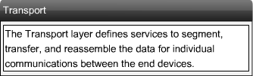
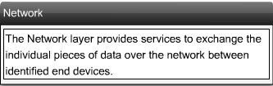
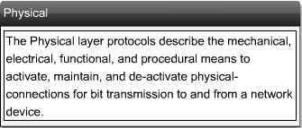
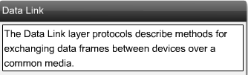

Slide 39
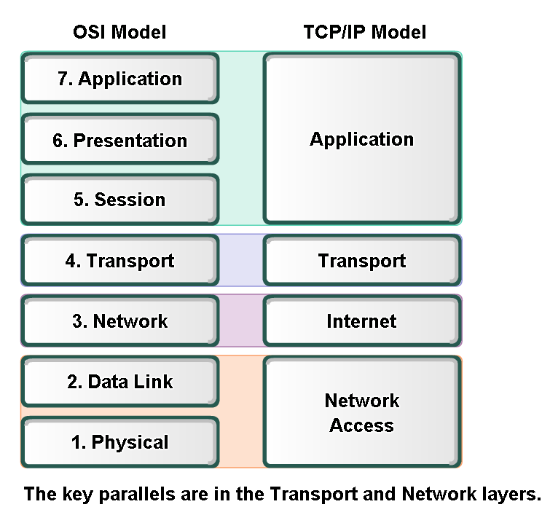
Layers with TCP/IP and OSI Model
Compare OSI and TCP/IP model

Slide 40
Comparisons
In the OSI model, the Network Access layer and the Application layer of the TCP/IP model are further divided to describe discreet functions that need to occur at these layers
At the Network Access Layer, the TCP/IP protocol suite does not specify which protocols to use when transmitting over a physical medium; it only describes the handoff from the Internet Layer to the physical network protocols
The OSI Layers 1 and 2 discuss the necessary procedures to access the media and the physical means to send data over a network.
The key parallels between the two network models occur at the OSI model Layers 3 and 4.
Layer 3 is used to discuss and document the range of processes that occur in all data networks to address and route messages through an internetwork. (IP)
Layer 4 is often used to describe general services or functions (error recovery and retransmissions) that manage individual conversations between source and destination hosts. (TCP and UDP)

Slide 41
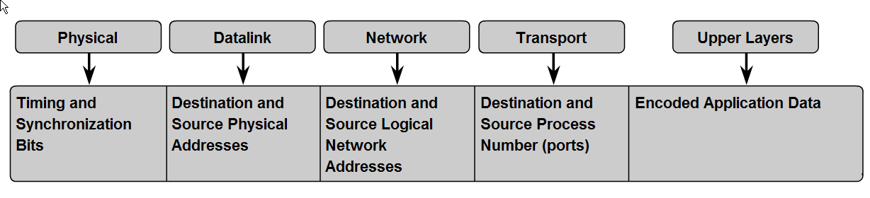
Addressing and Naming Schemes
Explain how labels in encapsulation headers are used to manage communication in data networks

Slide 42
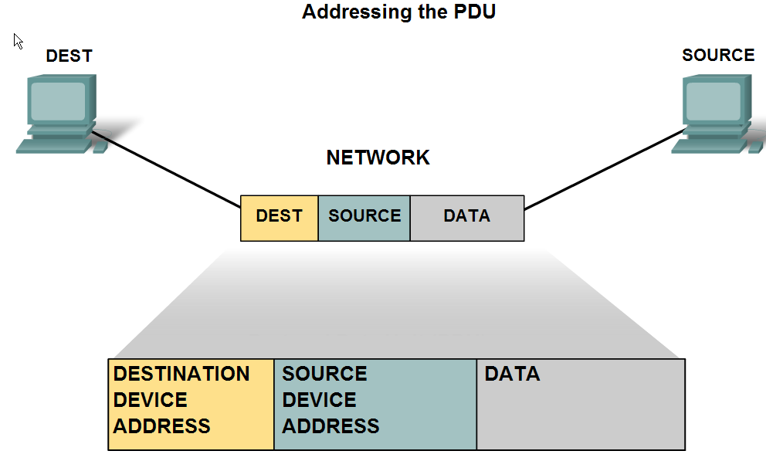
Addressing and Naming Schemes
Describe examples of Ethernet MAC Addresses, IP Addresses, and TCP/UDP Port numbers

Slide 43
Layer 2 Addressing
Layer 2 is concerned with the delivery of messages on a single local network.
The Layer 2 address is unique on the local network and represents the address of the end device on the physical media.
In a LAN using Ethernet, this address is called the Media Access Control (MAC) address.
When two end devices communicate on the local Ethernet network, the frames that are exchanged between them contain the destination and source MAC addresses.
Once a frame is successfully received by the destination host, the Layer 2 address information is removed as the data is decapsulated and moved up the protocol stack to Layer 3.

Slide 44
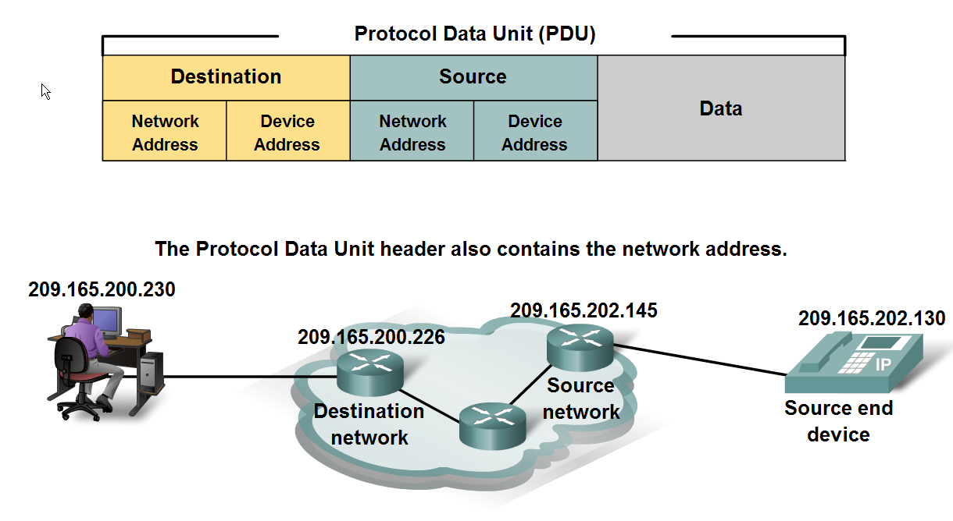
Addressing and Naming Schemes
Explain how labels in encapsulation headers are used to manage communication in data networks

Slide 45
Layer 3 Addressing
Layer 3 protocols are primarily designed to move data from one local network to another local network within an internetwork.
Whereas Layer 2 addresses are only used to communicate between devices on a single local network, Layer 3 addresses must include identifiers that enable intermediary network devices to locate hosts on different networks.
In the TCP/IP protocol suite, every IP host address contains information about the network where the host is located.
Routers use the network identifier portion of this address to determine which path to use to reach the destination host. Once the path is determined, the router encapsulates the packet in a new frame and sends it on its way toward the destination end device.

Slide 46
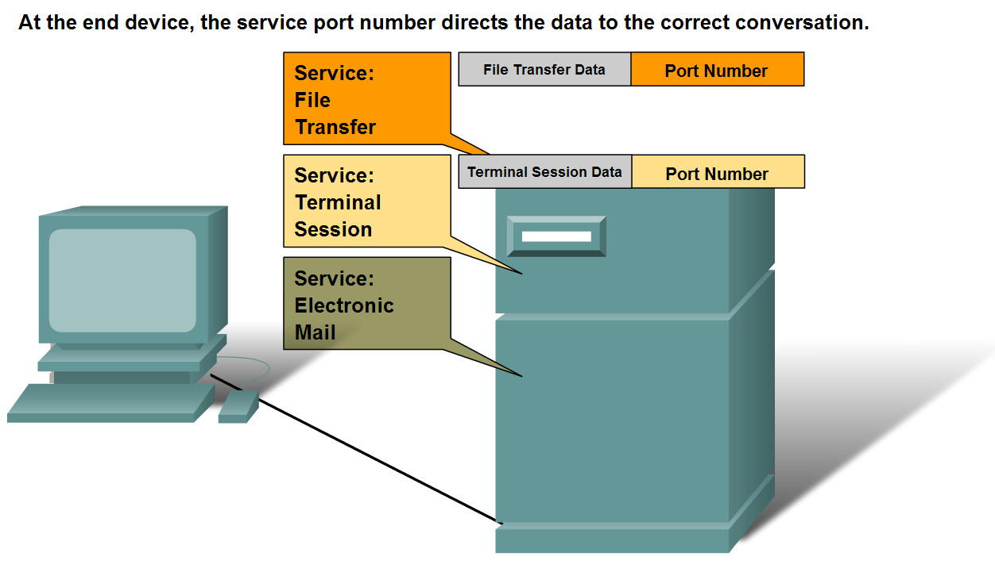
Addressing and Naming Schemes
Describe how information in the encapsulation header is used to identify the source and destination processes for data communication

Slide 47
Layer 4 Addressing
Each application or service is represented at Layer 4 by a port number.
A unique dialogue between devices is identified with a pair of Layer 4 source and destination port numbers that are representative of the two communicating applications.
When the data is received at the host, the port number is examined to determine which application or process is the correct destination for the data.

Slide 48
Cisco Port Numbers
0 – 1023 are well known port numbers
FTP – Port 21
Telnet – Port 23
SMTP – Port 25
DHCP – Port 67
HTTP – Port 80
Google Mail – Port 465

Slide 49
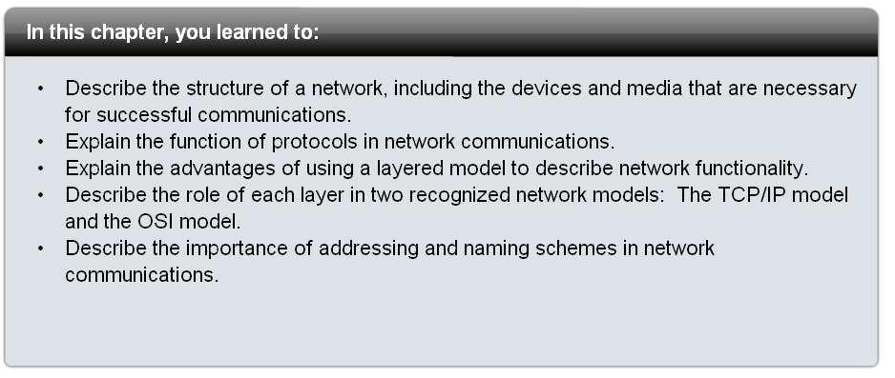
Summary

